Slide 1



..
Team
3-IDIOTS
Tusar Howlader[201-15-14006]
Arafat Islam Alif[201-15-14027]
Tanvir Islam[201-15-13898]

Slide 2
QUIZ APP
Git hub: https://github.com/tusar02/Quiz-App

Slide 3
About Our Project
The ‘Quiz App’ project developed to overcome the time consuming problem of manual system. Apart from that in current system, checking the answer sheets after taking test, waste the examiners time, so this application will check the correct answer and save the examiner time and carry the examination in an effective manner. The users which are use this system don’t need to high computing knowledge and also system will inform them while entering invalid data.

Slide 4
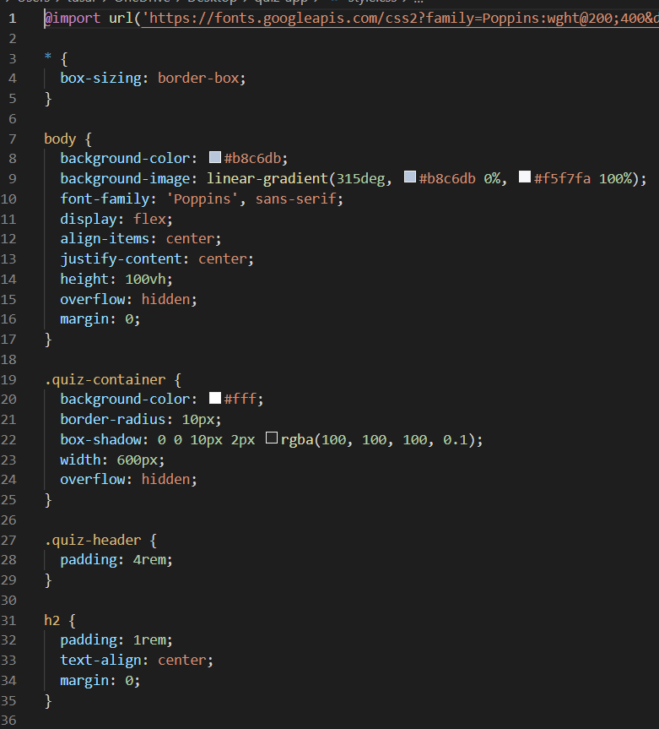
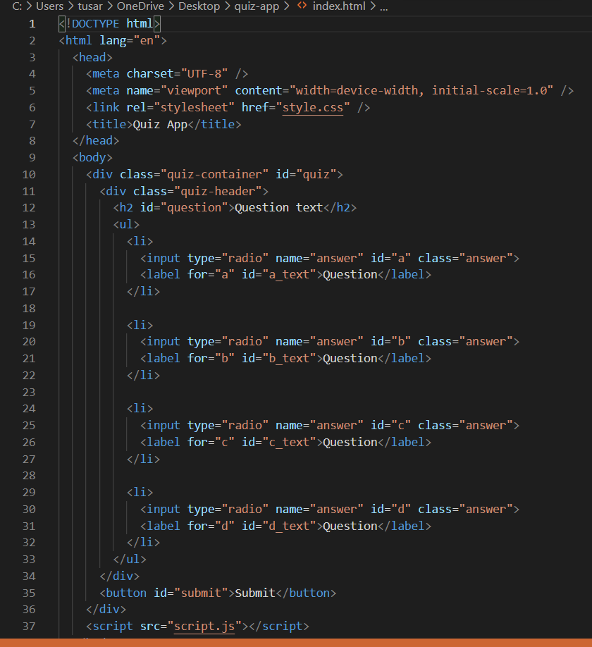
Procedure

Slide 5
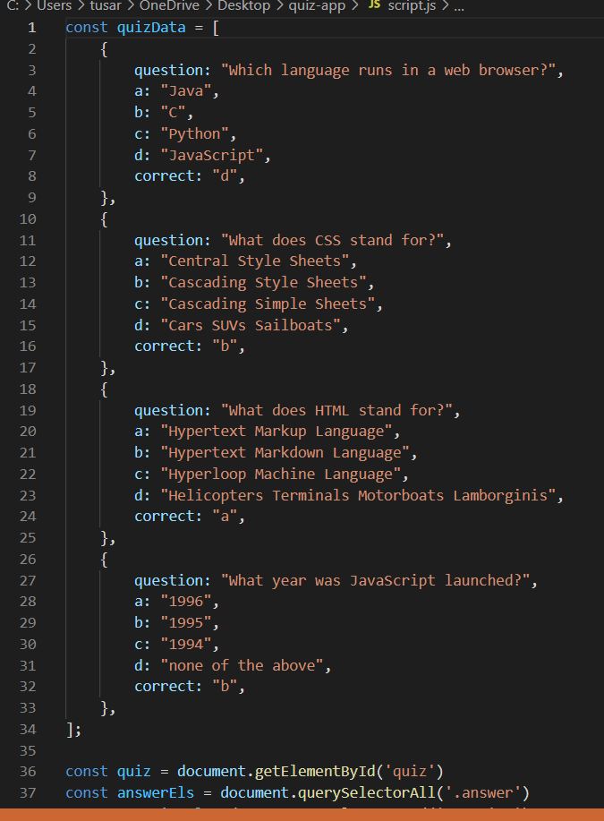
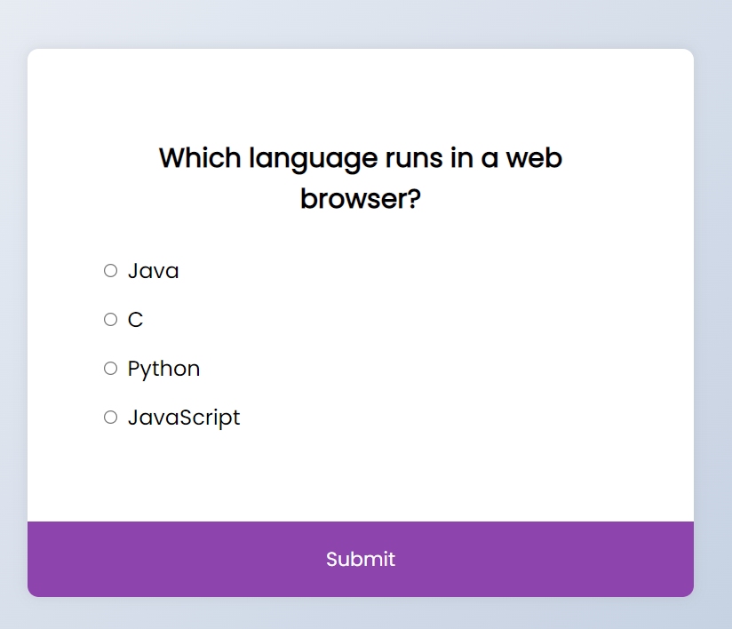
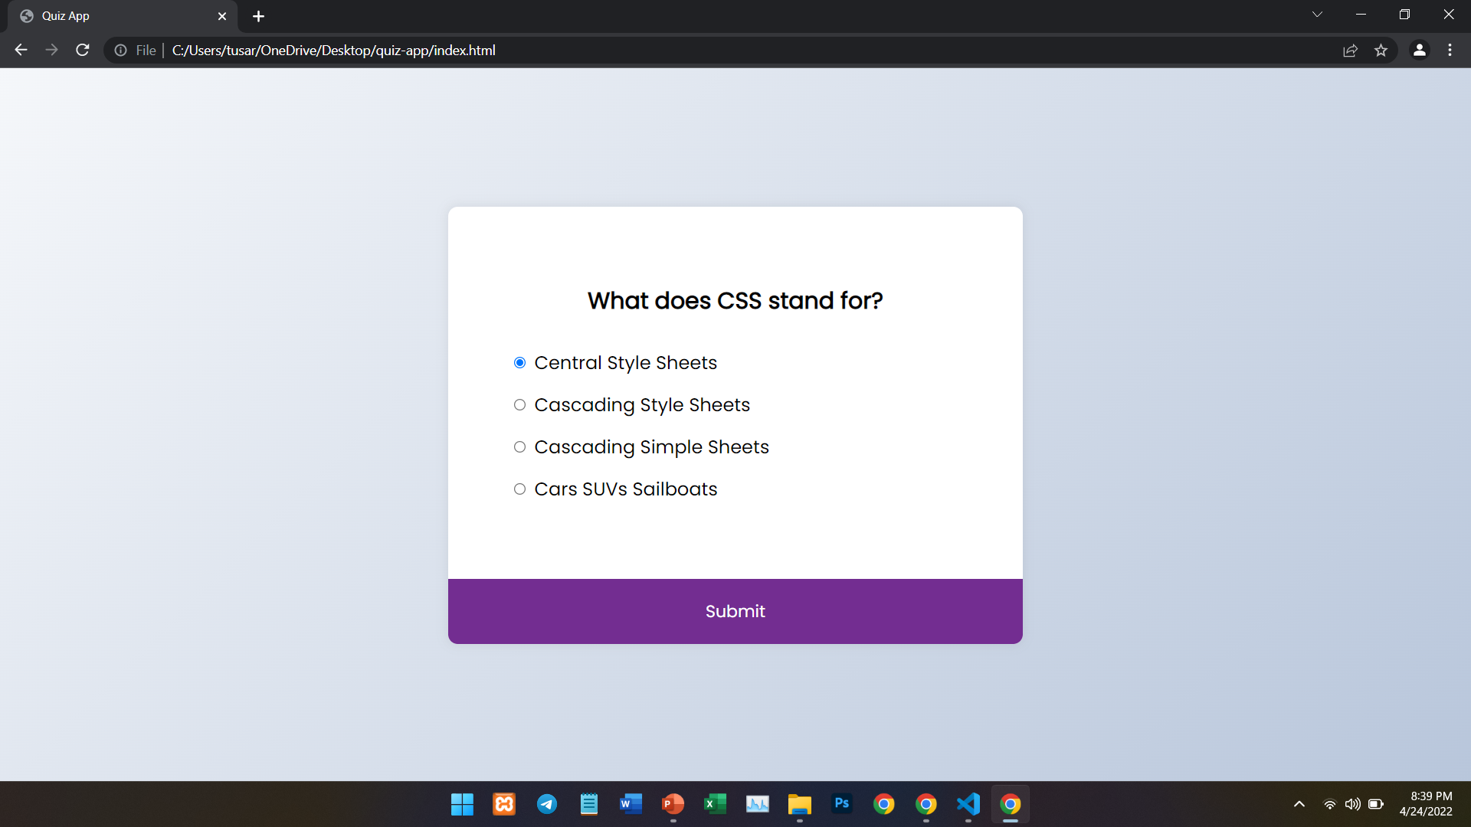
Procedure

Slide 6
Advantage of Quiz App
Engage your audience.
Randomizing questions.
No instructor needed.
Set timer.
Quiz results/ gain insight in audience.
Improved overview of the workforce.
Employee records can be searched very easily.

Slide 7


